Slide 1

Mass Storage Structure
Disk Structure
Disk Scheduling
Notes:
Disk formatting; Swap space; Management of boot blocks, Structure and operation of RAID systems

Slide 2
Disk Scheduling
A total of 153 head movements
Another variant is the C-LOOK scheduling algorithm
Choice of a disk scheduling algorithm is dependent on a number of factors
File allocation method
Location of directories and index blocks
Behavior of applications for generating disk requests
RAIDs – Redundant Array of Inexpensive/ Independent Disks
Notes:
SSTF: starvation may take place

Slide 3
Protection and Security
Protection Mechanisms
Security with Authentication and Authorization

Slide 4
Protection and Security
Protection mechanisms control access to a system by limiting the types of access to users
It must ensure that only authorized processes are allowed to operate on resources
The mechanism must provide the means for specifying the controls to be imposed with the means for enforcing them
Security ensures the authentication of system users to protect the integrity of information stored in the system
It is more an external problem
It prevents unauthorized access, malicious destruction or alteration of data and accidental introduction of inconsistency
Cryptography is a security enabler

Slide 5
System Protection
Processes must be protected from one another
Provide mechanism for controlling access to program, processes or users to the resources
Why protection?
Prevent mischievous, intentional violation of an access restriction by a user
Program components use system resources only on ways consistent with stated policies
Improves reliability by detecting latent errors at the interfaces between subsystems
Protection-oriented systems provides means to distinguish between authorized and unauthorized usage
Notes:
A protection system must have the flexibility of enforcing/ implementing a variety of policies

Slide 6
System Protection
Role of protection
Provide mechanism for enforcement of policies governing resource usage
Policies may be fixed or dynamic
Application programmer is also required to use various application related protection techniques
Principles of Protection
Principle of least privilege
Programs, users and the system are given just enough privileges to perform their tasks
Notes:
A protection system must have the flexibility of enforcing/ implementing a variety of policies

Slide 7
System Protection
It gives users, programs and systems just enough privilege to perform their tasks
System calls are provided to get indirect access to privileged resources
Helps create a more secure computing environment
Damage remains limited
Access Matrix
General model of protection
Rows represent domains, which is a set of access rights
Columns represent objects
Each entry consists of a set of access rights

Slide 8
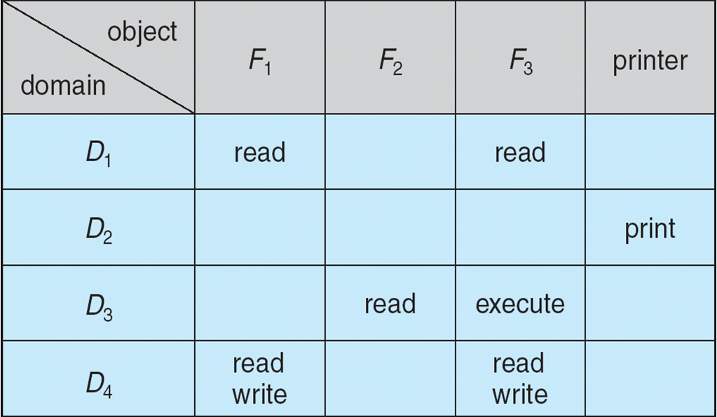
Access Matrix

Slide 9
System Protection
Permission to perform an operation on an object
The scheme provides the mechanism to implement a number of policies
Mechanism is that the OS provides access-matrix and specifies the rules
OS ensures that the matrix is only manipulated by authorized agents and that rules are strictly enforced
User gives the policy about who can access what object and in what mode
Processes should be able to switch from one domain to another
Protection is about how we provide controlled access to programs and data in a computer system

Slide 10
System Protection
Capability and language-based protection
Each row can be associated with a domain
Capability list for a domain
List of objects with the operations allowed on those objects
An object is represented by its capability
Language-based protection
Protection scheme is also available as a tool to the application designer
Compiler-Based Enforcement

Slide 11
System Security
Types of Security Breaches
Levels of Security Measures

Slide 12
Introduction to Security
Security considers the external environment with which the system operates
System must be guarded against
Unauthorized access
Malicious destruction or alteration
Accidental introduction of inconsistency
Security Problem
System is secure if its resources are used as intended under all circumstances
Security violations are categorized as intentional or accidental

Slide 13
System Security
Intruder and cracker
Those attempting to breach security
Threat: Potential for security violation
Attack: Attempt to break security
Accidental and malicious security violations
Breach of confidentiality
Unauthorized reading of data or theft of
information
Breach of Integrity
Unauthorized modification of data
Breach of availability
Unauthorized destruction of data
Theft of service
Unauthorized use of resources

Slide 14
System Security
Denial of service
Preventing legitimate use of the system
Common methods of breaching security
Masquerading
Participant in a communication pretends to be someone else
Attacker breaches authentication
Replay Attack
Malicious or fraudulent repeat of a valid data transmission
Done along with a modified message
3. Man-in-the-middle attack
Attacker sits in the data flow of a communication
Masquerading as sender to the receiver

Slide 15
System Security
Absolute protection of a system from malicious abuse is not possible
Security measures are taken at four levels
Physical
Sites with computer systems must be physically secured
2. Human
Authorization must be done carefully to allow only appropriate users to have access to the system
Phising:
Legitimate looking email or webpage misleads a user to enter confidential information

Slide 16
System Security
Dumpster diving:
Attempting to gather information to gain unauthorized access to the system
3. Operating System
System must protect itself from accidental or purposeful security breaches
4. Network
Intercepting data communicated over a network
Breaking into a computer
System must provide protection to allow the implementation of security features

